Slide 2
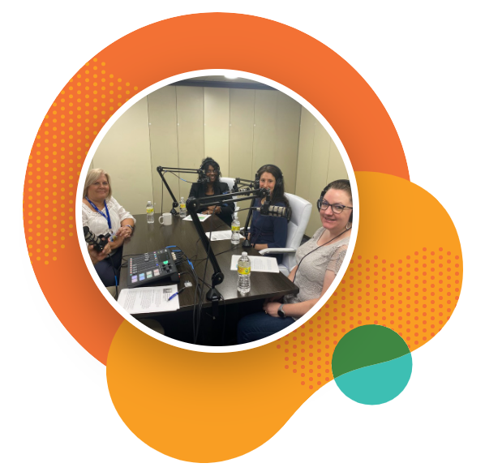
Boundless is a family of nonprofit companies with more than forty years of expertise providing person-centered care to people with intellectual and developmental disabilities (I/DD) and behavioral health challenges.
Our values of love, respect, empowerment, excellence, and wellbeing shine through in everything we do. That's why we were the first provider organization in Ohio to receive both Council On Quality and Leadership (CQL) and CARF accreditations.

Slide 3
Boundless offers a variety of virtual, center-based, and entirely community-based adult day, employment, and vocational training programs.
Our tailored offerings allow participants the chance to connect with others in their community through outings, activities, and hands-on learning opportunities.

Slide 4
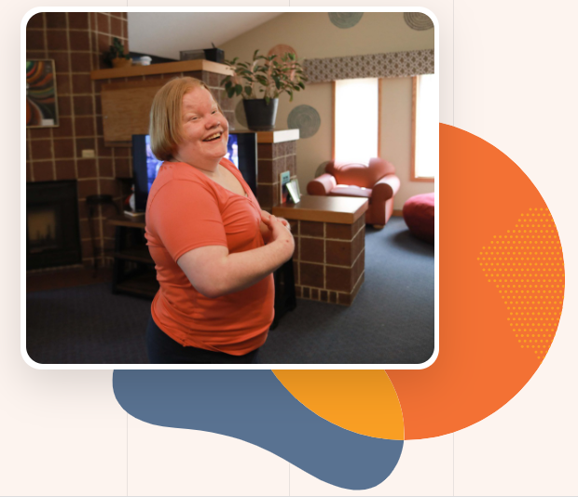
What are adult day programs?
Boundless offers a variety of virtual, center-based, and WOW adult day programs for adults with disabilities or behavioral health challenges such as autism. Our programs provide ongoing opportunities for people to connect with their peers, learn new skills, and explore their community.
What makes Boundless adult day programs stand out?
We take the time to get to know each of our participants and then develop person-centered programming that appeals to their individual needs and interests. We can even provide non-medical transportation to help people get where they need to go.

Slide 5
Dayton Area Programs
Vocational Habilitation WOW empowers people looking to better connect to their community. Our program focuses on skill development that encourages independence, self-determination, and a career path towards competitive, community employment.
Training opportunities include the production and distribution of Pets' N People Dog Biscuits, secure document destruction with Super Shred, and a variety of facility cleaning and housekeeping services.
Spire Arts is a vocational art program that provides person-centered care for adults with developmental disabilities who wish to create, explore, and sell art while developing job skills. Adults receiving services on our West Carrollton campus can participate in this unique program, one or two days a week.
Employment Services-Boundless provides job development services that help the people we serve find long-term employment in the community and ongoing job coaching to support employment long-term.

Slide 6
Area Programs
Vocational Habilitation WOW empowers people looking to better connect to their community. Our program focuses on skill development that encourages independence, self-determination, and a career path towards competitive, community employment.
Center-based programs
Primarily taking place on one of our campuses, center-based programs range from music lessons and yoga to afternoons spent in our dance studio and healthy cooking classes.
Spire Arts is a vocational art program that provides person-centered care for adults with developmental disabilities who wish to create, explore, and sell art while developing job skills. Adults receiving services on our West Carrollton campus can participate in this unique program, one or two days a week.
Vocational Training
Our passionate team of employment professionals focus on job development, community employment, and job coaching.
Employment Services-Boundless provides job development services that help the people we serve find long-term employment in the community and ongoing job coaching to support employment long-term.

Slide 7
What is OhioRISE?
Boundless is a care
management entity
(CME) for OhioRISE
(Resilience through
Integrated Systems and
Excellence) — a specialized
Medicaid managed care program
for children and youth with complex behavioral health (mental health/substance use disorder) and multi-system needs. Aetna Better Health of Ohio (Aetna) is the managed care partner for the program.

Slide 8
Boundless Health
Boundless Health is the newest addition to the
Boundless family–created specifically to
meet the primary and preventative healthcare
needs of individuals and families with intellectual
and developmental disabilities (I/DD) and
behavioral health challenges such as autism.
What Makes Us Special
We understand our patients' challenges in accessing necessary care and provide a safe, welcoming space to accommodate their individualized needs. We support our patients and families in ways traditional healthcare providers cannot, offering multiple services in a single location, same-day appointments, virtual video visits, extended office hours, and 24/7 access to primary care for urgent concerns.

Slide 9
Boundless Health
Our available primary care services: We offer an expanding list of primary and preventative care services. Our providers will also work with you to find specialists supported by your insurance plan, such as radiologists, gynecologists, and endocrinologists.
General Visits
We offer annual physicals, family planning, and well- and sick-child visits.
Medication and Vaccinations
Prescription refill requests and routine vaccinations are available as part of our suite of services.
Screening and Tests
Access screenings and treatments for chronic conditions like diabetes and high blood pressure, rapid tests for flu, strep, pregnancy, A1c, and more. Onsite blood draws and urine collection for lab testing are also offered.
Preventative Care
Health promotion and patient education are critical to our approach to preventative care.

Slide 10
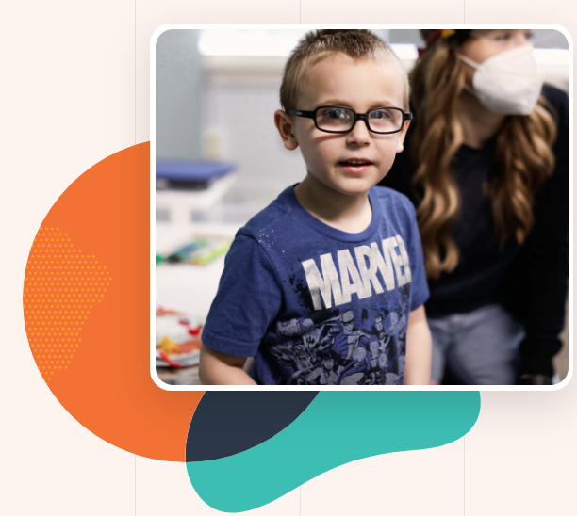
Other services provided:
Telehealth
After-School and Day Programs
Dental
Testing
Therapy
Autism Care
Community ABA Services
Care Coordination
Primary care

Slide 11
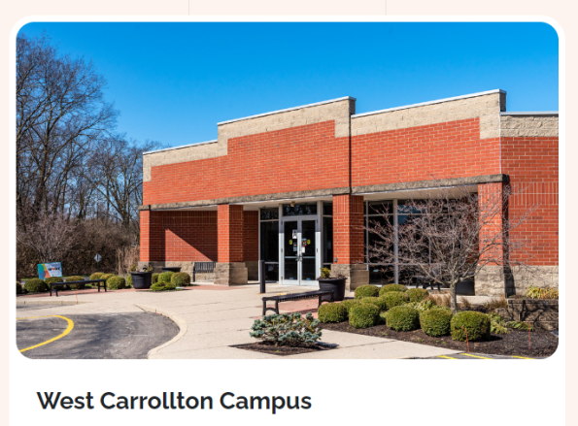
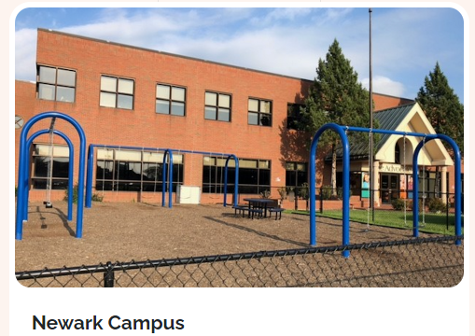
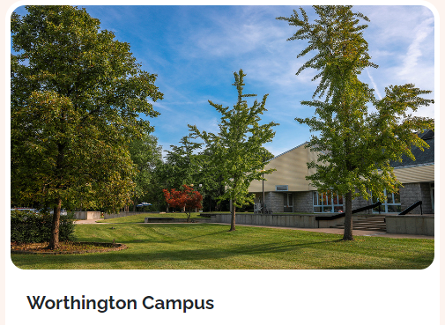
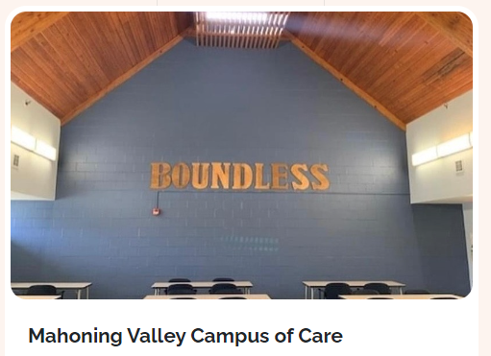
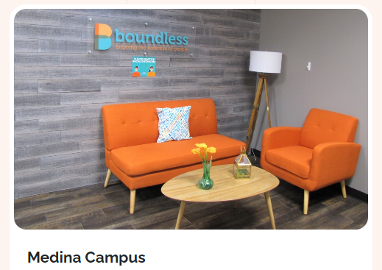
Locations

Slide 12
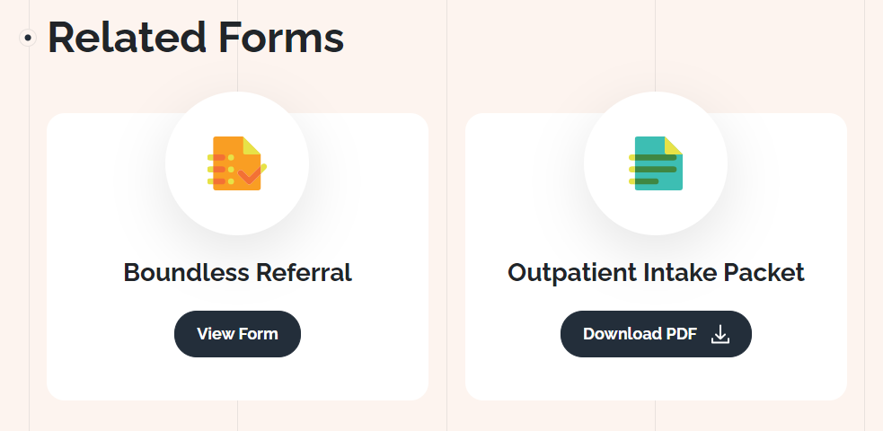
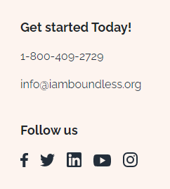
Forms found under :
Whole-Person Care, Community Services

Slide 13
Questions?
Stephan Cooke
OUTREACH MANAGER
Office: 614-844-3800 ext 2337 | Cell: 614-401-9754
Worthington, OH
West Carrollton, OH
scooke@iamboundless.org
iamboundless.org

Slide 14
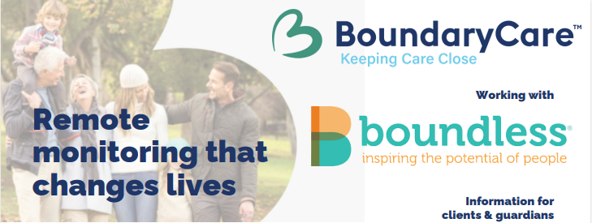

Slide 15
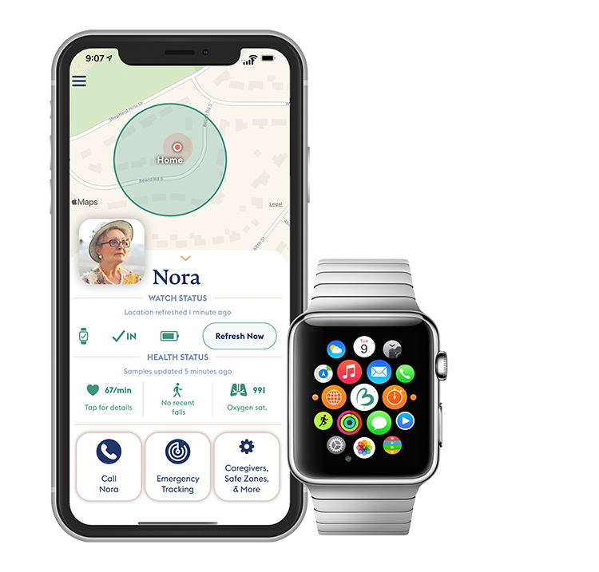
What is it?
BoundaryCare is an app that utilizes the features of an Apple Watch to collect health data (HR, step count, falls, activity) and location.
The information collected is then sent to a parent or care provider through the app.
Its goal is to help enhance independence, safety, and well-being through providing real-time updates.
BoundaryCare even includes 60 minutes of calling per month, to connect an individual to their support team!
BoundaryCare is available to not limited to individuals with ASD.

Slide 16
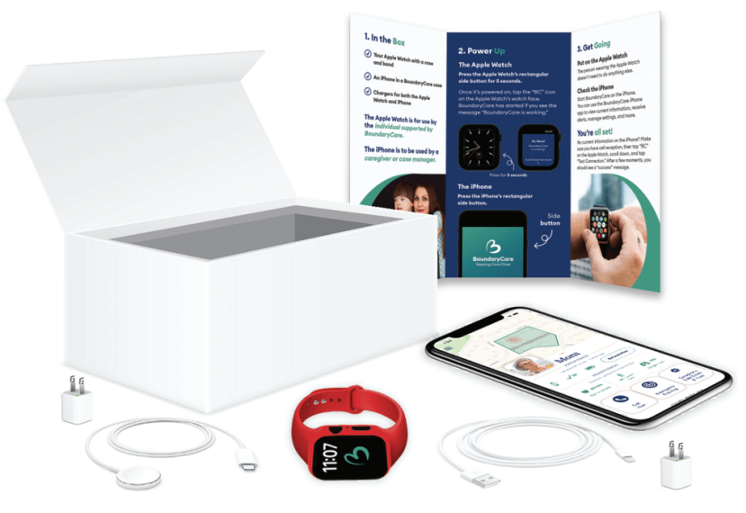
How it works.
When purchased through your waiver, BoundaryCare comes with a specially-configured Apple Watch and iPhone (everything pictured comes with the watch)
The individual wears the Apple Watch, and the support person keeps the phone. The BoundaryCare app can also be added to other phones in order to share the information.
Simply by wearing the Apple Watch, BoundaryCare will automatically send the individual’s health data (HR, activity/exercise, etc.) and location to the app, viewable on the phone.
To connect by voice, calls can be placed from the phone to the watch, with an available “auto-answer” features.

Slide 17
Monitoring
You choose what to monitor:
Low and high heartrate thresholds
Heart Rhythm
Step Count
Daily Exercise Minutes
Daily Energy Burn
Fall detection
Location (safe zones)
Microsurveys (Stoplight diet)
Oxygen Saturation

Slide 18
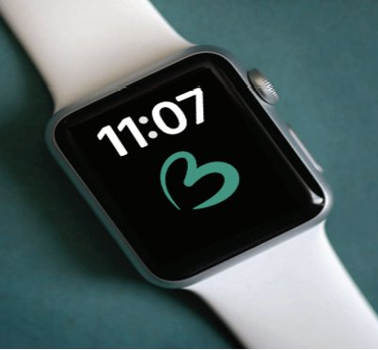
User Interaction
What does the person with the watch need to do?
Not much! Just put it on your wrist in the morning and back on the charger at night. Wellness data (agreed to by you) will be collected silently in the background.

Slide 19
Why?
Depending on your goals, BoundaryCare can be used to:
Promote Independence
Ensure safety and wellness by establishing safe zones for the individual (location; medication reminders)
Connect with an individual to call for support (calling with auto-answer)-the individual does not have to answer the call, it will be automatic for them to hear you
Achieve wellness goals (step count; exercise)

Slide 20
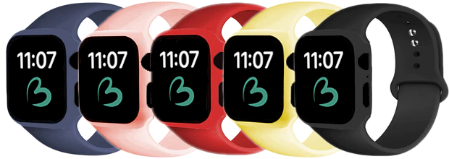
Eligibility
An individual must have an IO, Level One, or SELF Waiver for Boundless to be able to provide BoundaryCare
(watch, phone, and app)

Slide 21
To learn more, contact Ryan Burnett at:
AssistiveTechnology@iamboundless.org

